Slide 1
Magnetoreception: biology, physics, and math
Bob Fitak, PhD
Sensory biology class
Aug 1-2, 2017
Duke University

Slide 2
Outline
Day 1
Day 2
Magnetoreception
Circular statistics
Prep Experiment
Perform Pill bug experiment
Analyze our data!

Slide 3
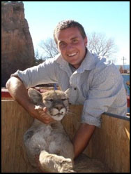





Bob Fitak, PhD
OSU
UA
D
EDUNI

Slide 4
What is magnetoreception?

Slide 5
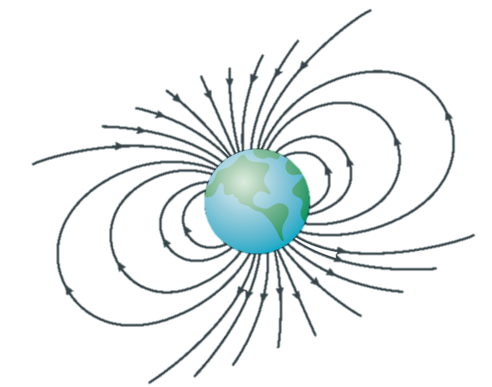

Earth’s Magnetic Field
Notes:
If you’ve ever used a compass then you are familiar with the earths magnetic field.

Slide 6
Activity
With a partner, get a magnet, a compass, and a colored sticker
Part 1:
Find magnetic North (N). Remember, the colored tip of a compass is the N pole (this is almost a trick question).
Part 2:
Using these materials, identify the N pole of the magnet and label it with a colored sticker
Part 2:
Find a place in the classroom where the compass reading is incorrect. Why?

Slide 7
Earth’s Magnetic Field
Notes:
If you’ve ever used a compass then you are familiar with the earths magnetic field.

Slide 8

Earth’s Magnetic Field
Notes:
Last major reversal ocurred ~800k years ago

Slide 9
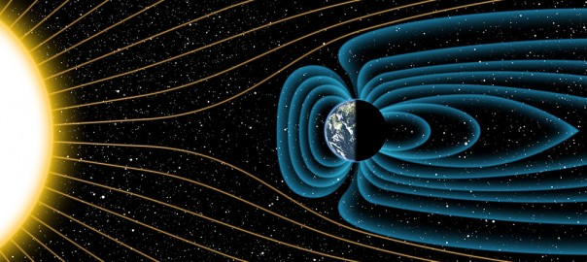
Earth’s Magnetic Field
www.astro-scutum.com

Slide 10
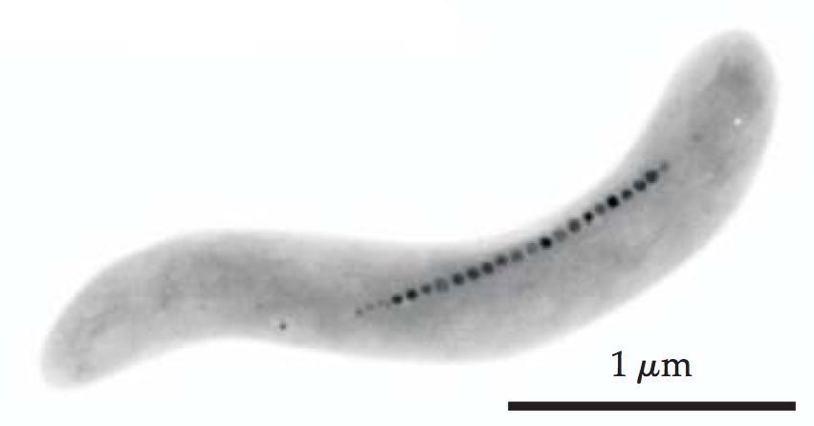
Magnetoreception
Johnsen & Lohmann 2008

Slide 11
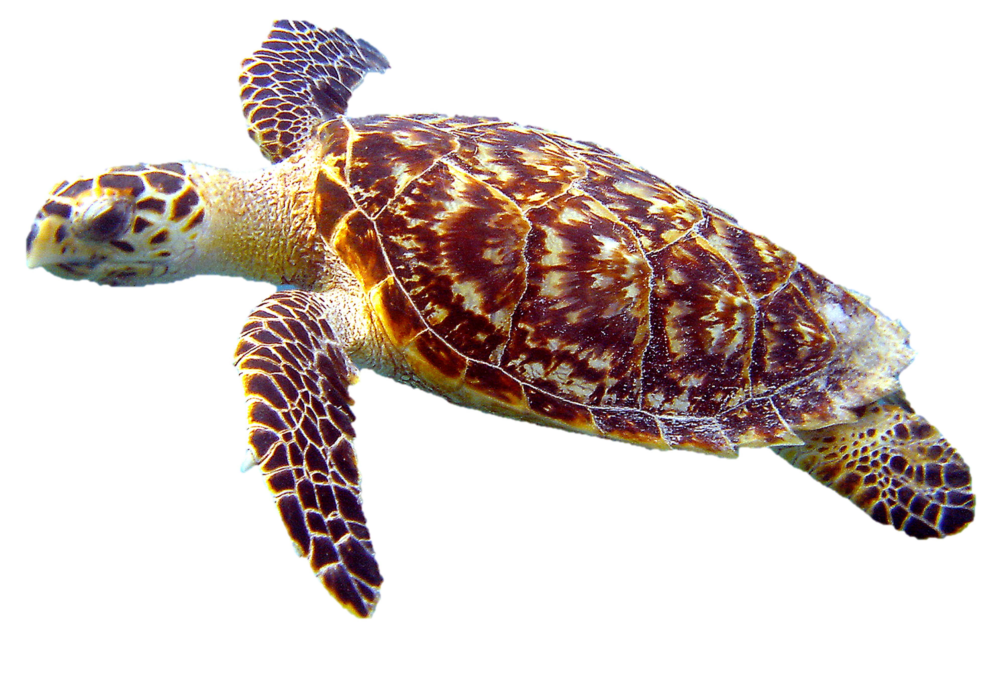
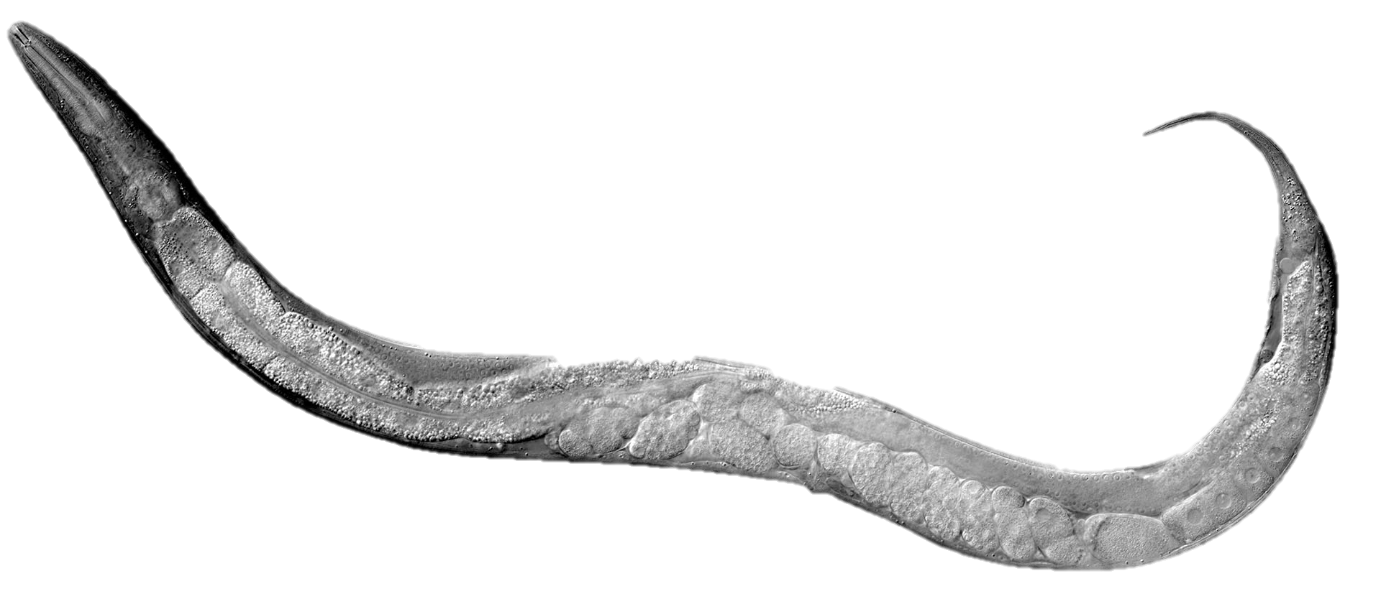
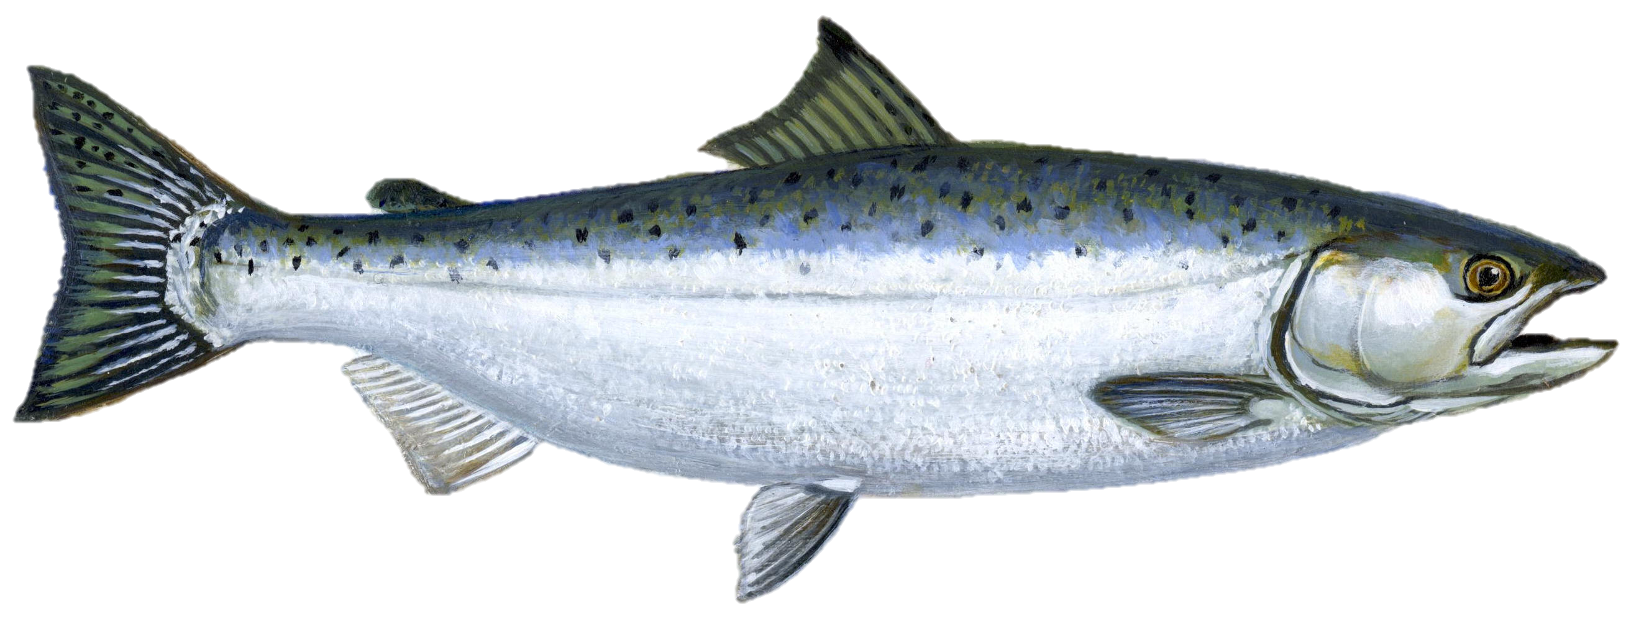
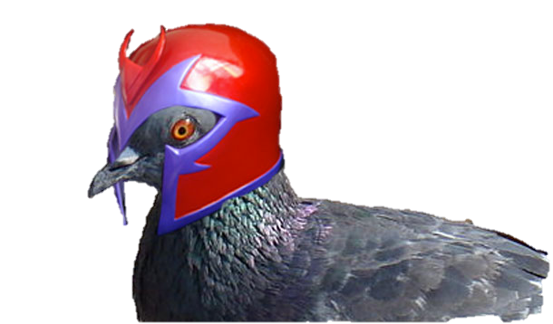
Magnetoreception in Animals
Notes:
Behavior based, suggests many species may sense magnetic fields
difficult to experimentally manipulate.

Slide 12
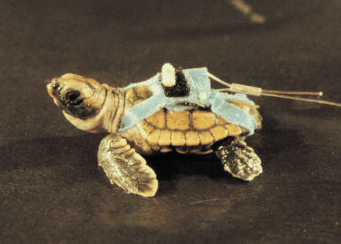
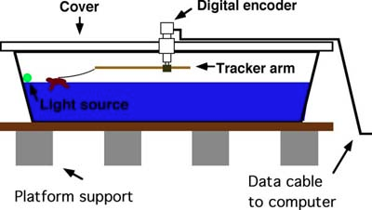
Behavior Experiments
Irwin, W. P. and Lohmann, K. J. (2003). Magnet-induced disorientation in hatchling
loggerhead sea turtles. J Exp Biol 206: 497-501.

Slide 13
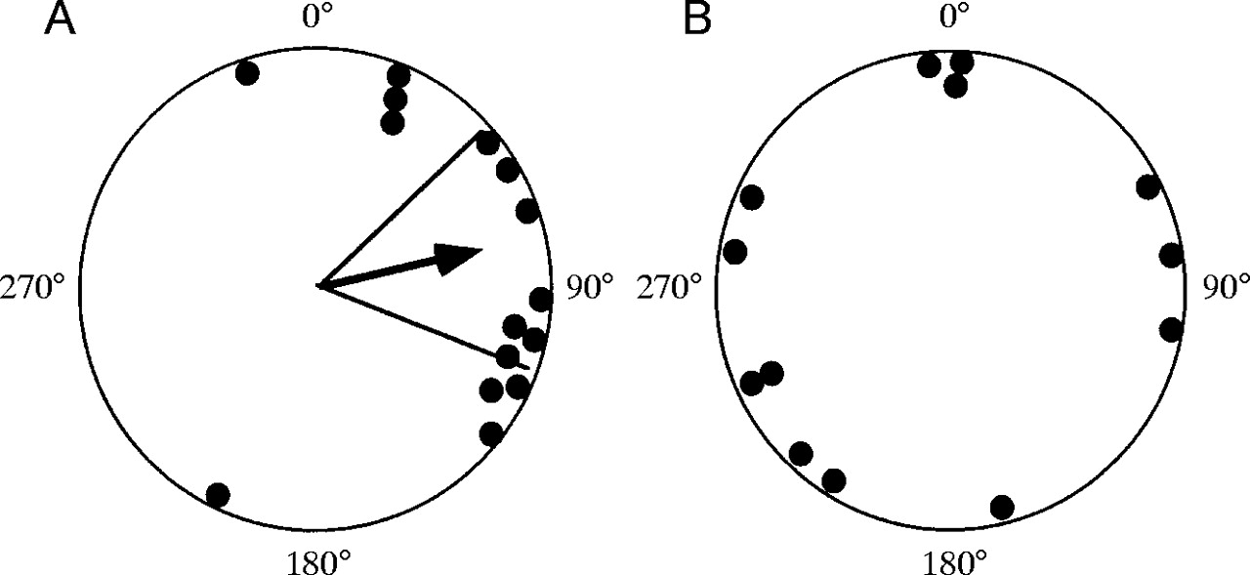
Behavior Experiments
Control Turtles
Turtles with Magnet

Slide 14
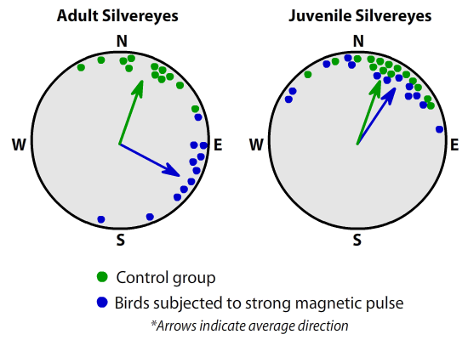
Behavior Experiments
Control Turtles
Turtles with Magnet
Munro U et al. (1997) Evidence for a magnetite-based navigational ‘map’ in birds. Naturwissenschaften 84:26–28

Slide 15
Mechanisms

Slide 16
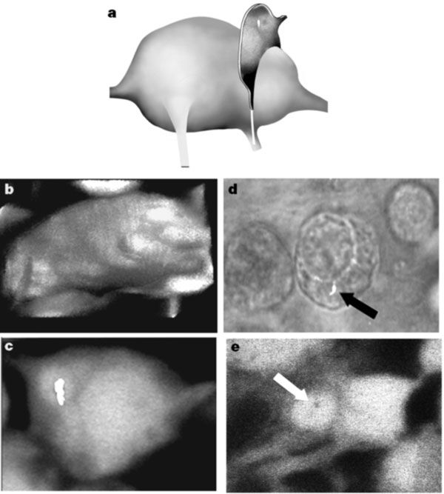
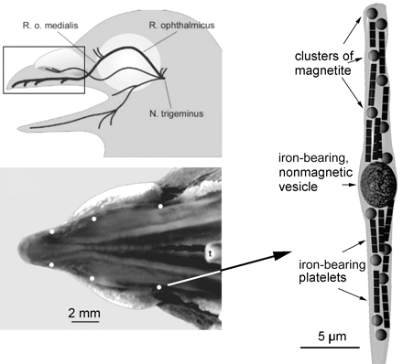
Physical Evidence
Diebel et al. (2000). Magnetite defines a vertebrate magnetoreceptor. Nature 406, 299–302
Fleissner et al. (2003) Ultrastructural analysis of a putative magnetoreceptor in the beak of homing pigeons. J Comp Neurol 458:350-60

Slide 17
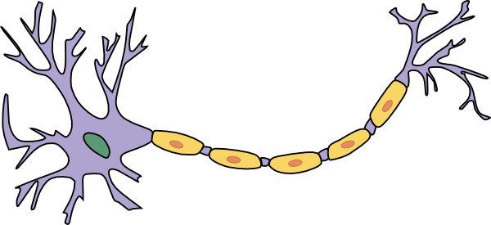
Ferrimagnetism
Ca²⁺
Na⁺
Na⁺
Ca²⁺
Ca²⁺
Outside
Inside
Nerve cell

Slide 18
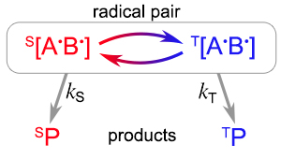
Radical Pairs Mechanism
B*
Vertebrate Eye
Notes:
Inclination only sensor
Cryptochrome blue-light sensitive photoreceptor

Slide 19
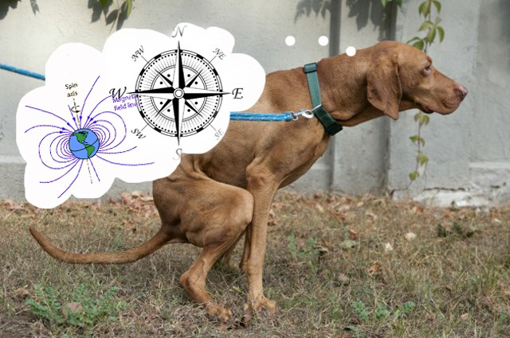
Crazy magnetoreception experiments
Hart et al.(2013). Frontiers in Zoology, 10:80

Slide 20
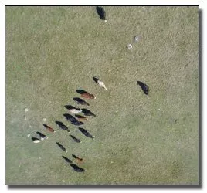
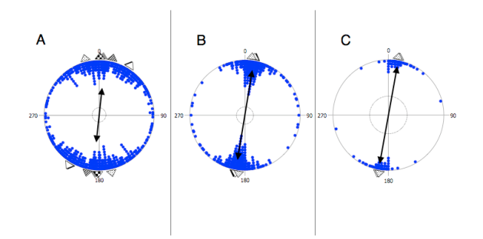
Crazy magnetoreception experiments
Begall et al. (2009). Magnetic alignment in grazing and resting cattle and deer. Proc Natl Acad Sci. 105(36):13451-13455.

Slide 21
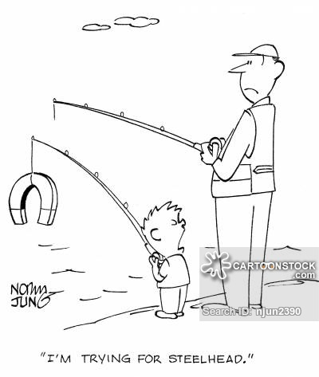
Thanks!!!!
Questions?

Slide 22
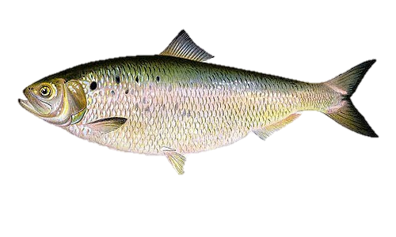
Conclusions and Future Work
Ferromagnetism vs. radical pairs mechanism?
Other tissues?
Other species
Pineal gland
Retina
American shad
Alosa sapidissima

Slide 23
Magnetic Pulse Experiment
Pulse-magnetized
Control
Notes:
Often used as the smoking gun in behavior experiments for determining magnetite-based mechanism

